Slide 1

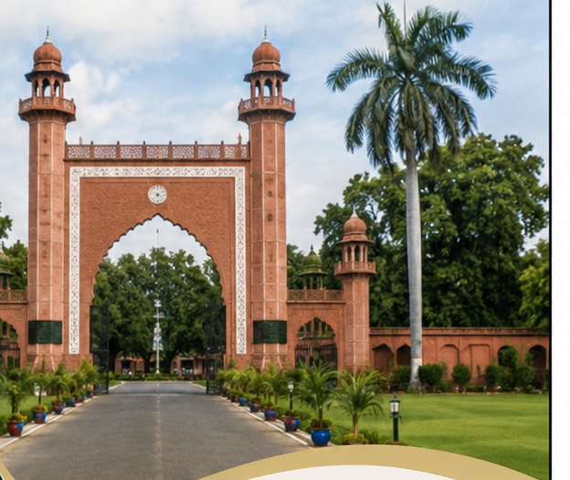
ISSUE 01
August 2026
Aligarh Muslim University
MAGAZINE
ACADEMICS
Shaping Minds,
Building Futures
INNOVATION
Ideas Today,
Impact Tomorrow
CAMPUS LIFE
Beyond Classrooms,
Beyond Boundaries
From Aligarh
to the World,
Inspiring Generations
Since 1920.
HERITAGE
Our Roots,
Our Pride
ALIGARH MUSLIM UNIVERSITY, ALIGARH, UTTAR PRADESH-202001

